Slide 1
Gaming - Minimax
Santosh GSK
Industry Expert- AI

Slide 2
AI Basics
So far, we discussed the foundations of building AI agents
Defining AI
Rational Agents
Task Environments
Search Strategies
Knowledge Representation and Reasoning
Learning and Optimization

Slide 3
AI Applications
Practical Applications
Gaming
Language Understanding
Computer Vision
Robotics
Speech
Many success stories in every application domain

Slide 4
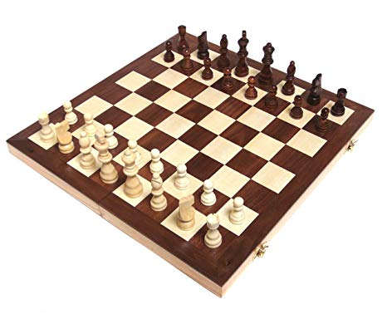
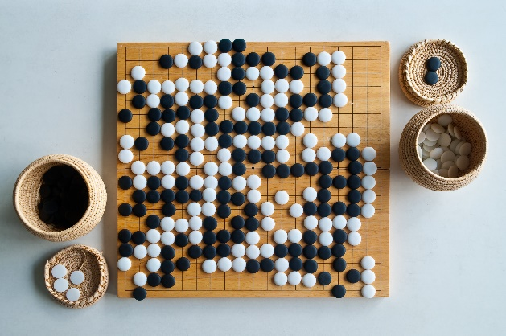
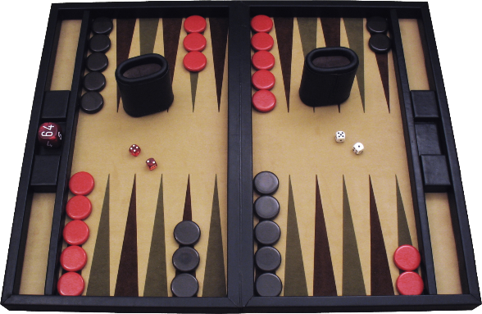
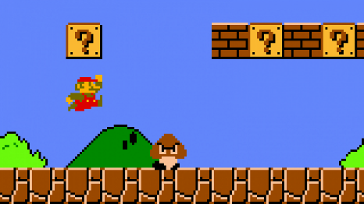
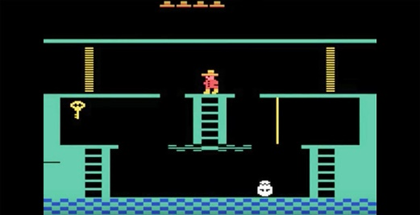
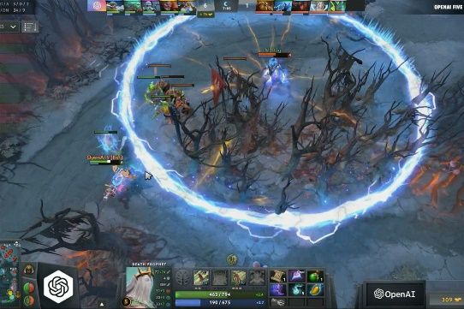
AI Application: Gaming
Games
Board Games
Chess
Backgammon
Go
Computer Games
Mario
Montezuma Revenge
DOTA

Slide 5
Why Gaming for AI?
Games are hard and interesting problems
- Requires effort and skills
- Hard because their finite state space is vast
- Complexity raises when the vast search spaces feature small feasible spaces (solutions)
- Evaluation of a game state is hard
- NP-Hard problems (nondeterministic polynomial time), i.e., worst case complexity is very high

Slide 6
Why Gaming for AI?
2. Rich Human-Computer Interaction
- Dynamic media
- Available options for interaction (keyboard, game controllers, body movements, speech, etc.)
- Gives rich player experience stimuli and player emotional manifestations
Such information advances our knowledge about human behaviour and emotion
Contributes to the design of better Human-Computer Interaction

Slide 7
Why Gaming for AI?
3. Games are popular
- Games generate approximately $120 billion in revenue in 2019
- Multitude of devices offer games (mobile, Tablet, VR, console, Arcade)
- Multitude purposes (games for art, games for change, games for education, games for training and health, etc.)
- Popularity drives content. Game content challenges the algorithmic efficiency in AI
- More data. Better models.

Slide 8
Why Gaming for AI?
4. Challenges for all areas of AI
- Machine Learning – Go and arcade games
- Tree Search – Checkers and Chess games
- Knowledge representation and reasoning – Jeopardy!
- Natural Language Processing – Jeopardy!

Slide 9
Brief History of AI and Games
Much past research on AI for games concerned with constructing agents for playing games without learning component.
First software that mastered a game was programmed by A.S. Douglas in 1952 on a digital version of Tic-Tac-Toe
Arthur Samuel was the first to invent the form of ML now called RL using a program that learned to play Checkers by playing against itself

Slide 10
Brief History of AI and Games
Early research focused on board games, e.g., Checkers and Chess
Conception that they are of great complexity and challenged best minds for decades
In 1994, the Chinook Checkers player managed to beat the World Checkers Champion Marion Tinsley; the game was eventually solved in 2007

Slide 11
Brief History of AI and Games
Chess was considered ”the drosophila of AI” for decades (uncountable new AI methods were tested upon)
In 1997, IBM’s Deep Blue, consisted of Minimax algorithm with chess specific modifications and a highly tuned evaluation function running on custom supercomputer, beat the Grand Master Garry Kasparov
It is now possible to download public domain software that can play better than any human on a regular laptop

Slide 12
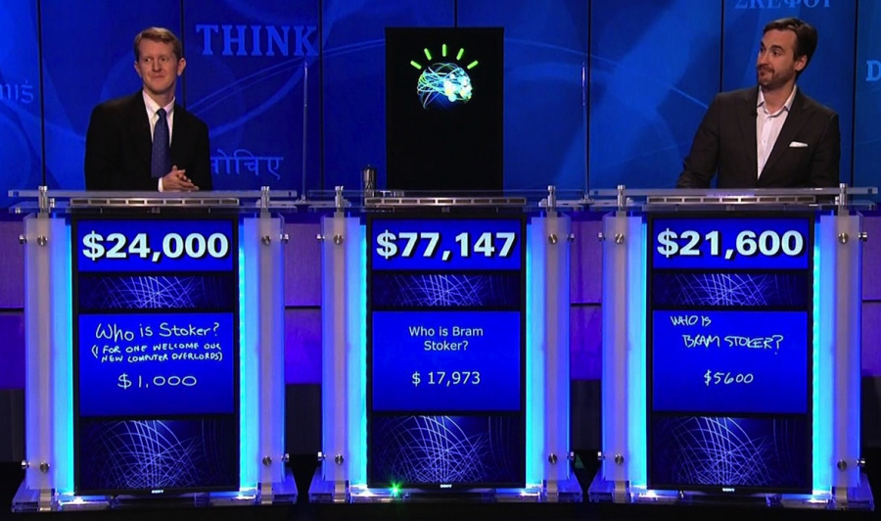
Brief History of AI and Games
In 2011, IBM’s Watson competed in Jeopardy! answering questions in natural language and won against former winners of the game

Slide 13
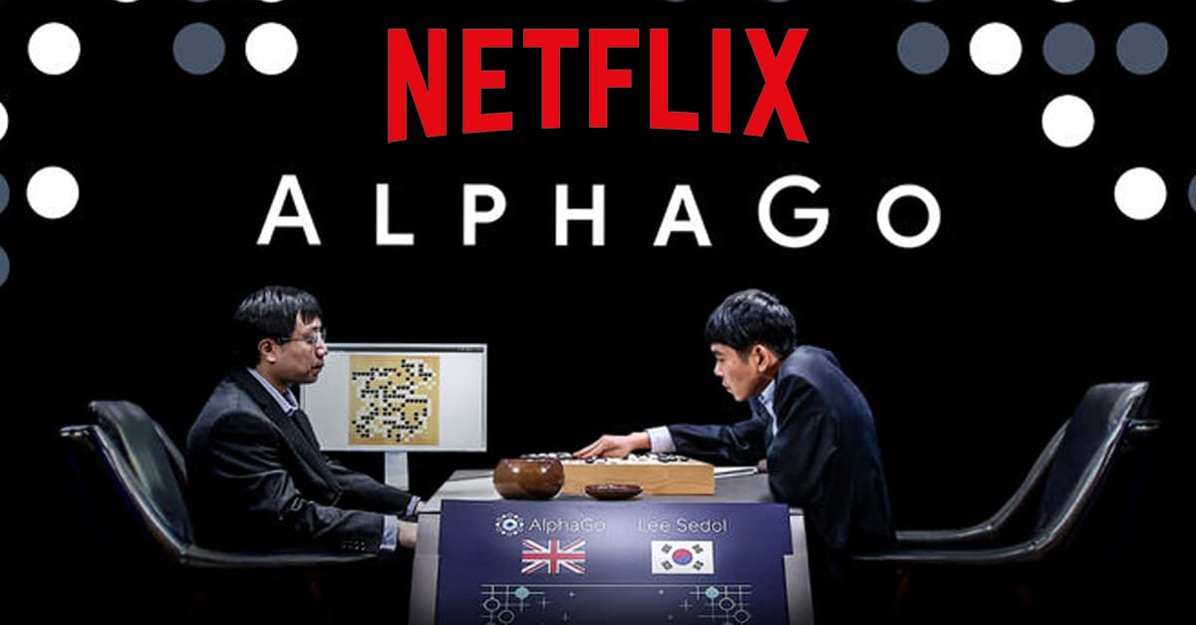
Brief History of AI and Games
In 2016, board game Go with a branching factor of 250 considered to be the toughest was beaten by Deepmind’s AlphaGo
While human level Go playing system was expected in far future, AlphaGo has beaten Lee Sedol, 9-dan professional Go player

Slide 14
Brief History of AI and Games
Apart from board games, large part of research focused on developing AI for playing video games as effective as humans
In 2014, Deepmind learned to play several games from Atari 2600 video game console on a super-human level just from raw pixels

Slide 15
Brief History of AI and Games
AI was used to generate procedural content
Certain video games created content algorithmically during runtime
In 1980, Rogue game had dungeons and placement of creatures and items generated every time a new game starts
In recent past, Diablo III (2012), No Man’s Sky (2016), Chalice Dungeons of Bloodborne (2015)

Slide 16
Brief History of AI and Games
AI is also used to analyze games and model players of game
Game developers need to create games that can appeal to diverse audience
E.g., Farmville, Facebook Game were benefited from data collection
Nevermind game can track emotional changes of the player and adapt the game accordingly

Slide 17
Game Characteristics
Design of a game greatly influencing the AI design considerations
Primarily any game can be represented in four dimensions
Observability
Stochasticity
Time granularity
Number of players

Slide 18
Observability
Refers to how much information about the game state is available
Classic board games like Chess, Checkers, Go has full board state available to the players
They have perfect information
In games like Super Mario Bros or card games have only a part of the world visible at any point in time
Such games have hidden information and hence they are partially observable.

Slide 19
Stochasticity
It is the non-deterministic behavior of games, e.g., Monopoly
It is common for games to have mostly or fully deterministic games combined with some stochastic element through card-drawing or dice-rolling to reduce the probability of planning
In stochastic games, the outcomes are not entirely determined by the actions of the players

Slide 20
Time Granularity
Number of actions a player can take in a second
E.g., in Chess with two players a game would last for an average of 40 turns,
Whereas in Starcraft, a real-time strategy game, each second a player would make 3-5 actions
Time granularity affects AI game-playing algorithms through limiting how far ahead one can look.
A look ahead depth of 10 would mean very different outcomes depending on the game

Slide 21
Number of Players
The number of players in a game can determine the AI architecture design
If the game has only one player, standard single-agent tree search algorithms such as breadth-first, depth-first, A* would do well
If the game has two players zero-sum adversarial games, the minimax algorithm with alpha-beta pruning would work well
With many players, the above methods would suffer with computational complexity. Methods that can model single player with a model for rest of the players can work for such scenarios.

Slide 22
Defining Games
Playing a game can be defined as a search problem with the following elements:
INITIAL STATE: S₀, specifies how the game is setup at the start
PLAYER(s): Defines which player has the move in state s
ACTIONS(s): Returns the set of legal moves in state s
RESULT(s, a): The transition model, which defines the result of move
TERMINAL-TEST(s): A terminal test which is true when the game is over and false otherwise. States where the game has ended are terminal states
UTILITY(s, p): A utility function which defines a numeric value for a game that ends in a terminal state s for player p. In chess, possible utility results are win, loss or draw with values +1, 0, ½. Other games like backgammon have varied utility values ranging from 0 to +192.

Slide 23
Defining Games
Zero-sum game: Total payoff to all players is the same, i.e., if one player wins the other looses and vice-versa.
Chess is a zero-sum game as every game can end up with payoffs like (0, 1) or (½, ½) or (1, 0). The total payoff is constant across possibilities.
Adversarial Games: Goals of agents are in conflict where one’s optimized step would reduce the utility value of the other.

Slide 24
Defining Games
Game Tree: INITIAL STATE, ACTIONS and RESULT functions define the game tree for a game. It is a tree where nodes are game states and edges are moves.

Slide 25
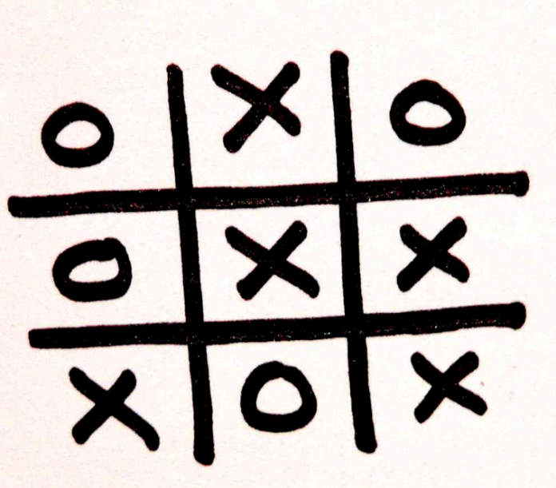
Game Tree: Example
Let us consider the game of Tic Tac Toe

Slide 26
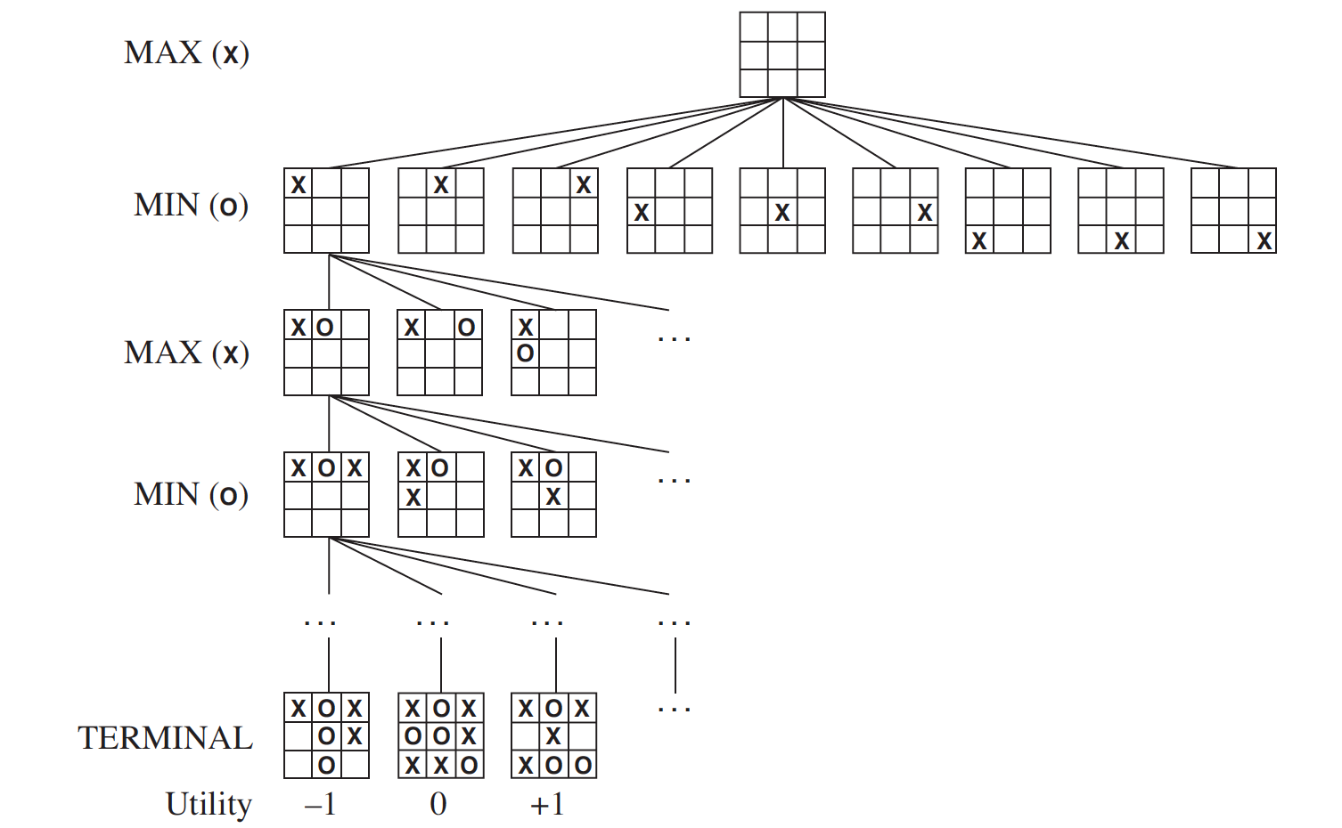
Game Tree: Example
Two players:
MAX(x) and MIN(o)

Slide 27
Game Tree: Example
MAX job: reach a terminal state to maximize the utility score
MIN job: reach a terminal state to minimize the utility score

Slide 28
Game Tree: Example
Search Tree: Tree superimposed on the full game tree and examines enough nodes to allow a player to determine what move to make
Tic-Tac-Toe: Possible nodes = 9! = 362, 880 nodes
<< Chess: 10⁴⁰
Only for theoretical understanding, cannot be used for large branching games

Slide 29
Game Strategy
How does the player MAX decide which action to take?
In a normal search strategies, the optimal action would be a part of sequence of actions that would lead to a terminal state with highest value
However, the second player MIN would now be a part of search strategy attempting to minimize the chances of MAX’s objective

Slide 30
Game Strategy
MAX should find a contingent strategy
Specifying MAX’s move in initial state
Then MAX’s move in states resulting from every possible response by MIN and so on
Optimal Strategy: A strategy that leads to outcomes that are atleast as good as any other strategy when one is playing against a perfect opponent.

Slide 31
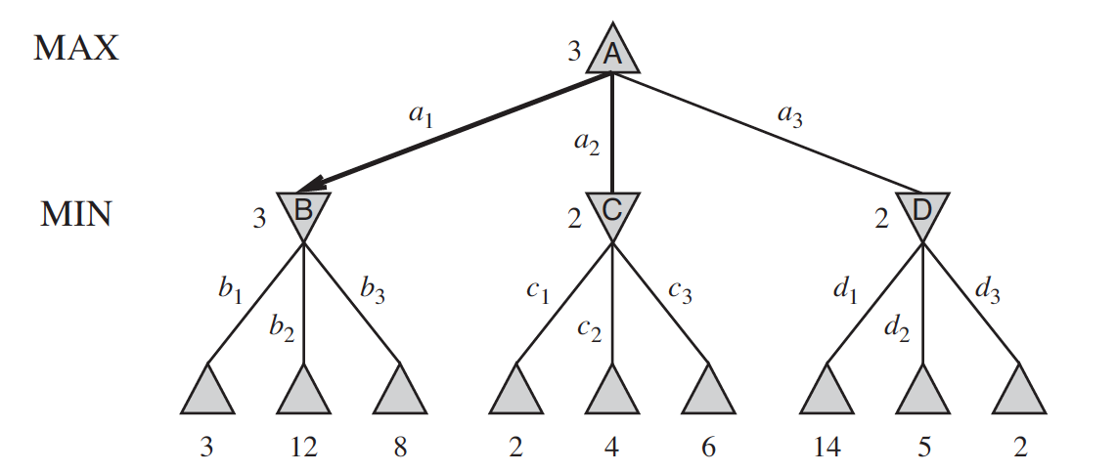
Optimal Strategy
A hypothetical game with three moves at every turn for each player
Game ends after one move from MAX and one move from MIN
Ply: Each move is called a ply.

Slide 32
Optimal Strategy
Given the game tree, the optimal strategy can be determined from minimax values of each node, written as MINIMAX(n) for node n
Minimax value of a node: Utility (of MAX) of being in the corresponding state, assuming both players would play optimally from the node n till the end of game
Minimax value of terminal node: Its Utility value

Slide 33
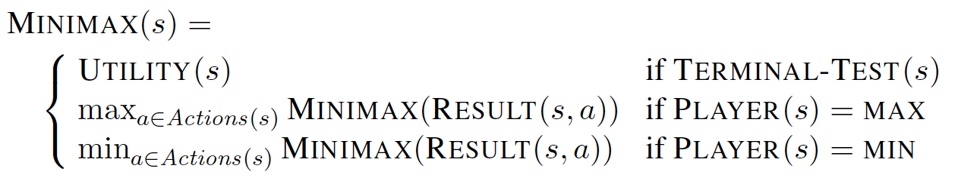
Optimal Strategy
Given a choice, MAX would choose to move to a state of maximum Minimax value whereas MIN prefers a state of minimum Minimax value

Slide 34
Optimal Strategy: Example

Slide 35
Minimax algorithm
Minimax algorithm: Computes the minimax decision from current state
Uses simple recursive computation to calculate minimax values of the successor states
Recursion proceeds until the terminal nodes, then the minimax values are backed up through the tree as recursion unwinds

Slide 36
Minimax algorithm
Performs a complete depth-first exploration of game tree
If max depth of game tree is m and there are b legal moves at each state, i.e., branching factor, then
Time Complexity is O(b^{m})
Space Complexity is O(bm) for generating all actions at once
Else O(m) for generating actions one at a time
For real games, impractical
However, Minimax algorithm serves as a basis for mathematical analysis of games and for more practical algorithms

Slide 37
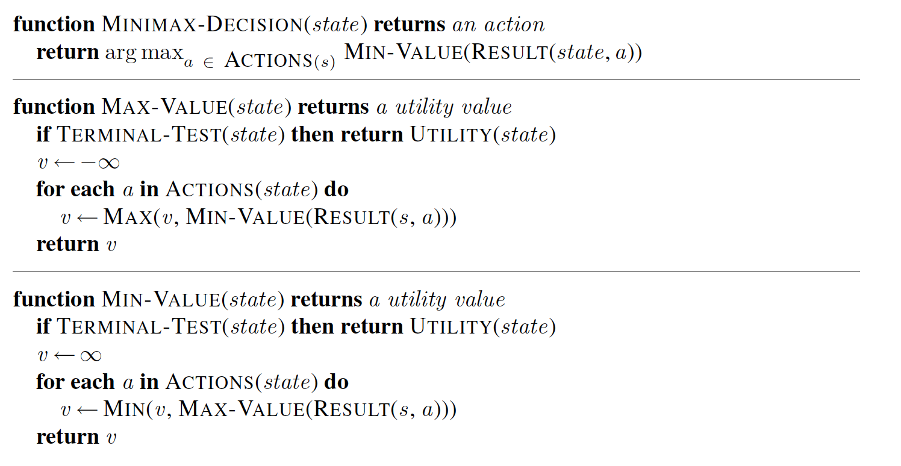
Minimax Algorithm

Slide 38
Multiplayer Games
Many games have more than 2 players
How to extend minimax to multiplayer games?
Replace the single value for each node with a vector of values
Ex: In a three player game with players A, B and C, a vector <v_{A}, v_{B}, v_{C}> is associated with each node

Slide 39
Multiplayer Games
For terminal states, this vector gives the utility value from each player’s viewpoint
For non-terminal states, look at all possible actions and their minimax vectors. Choose that action where the player’s component in the vectors is maximized.

Slide 40
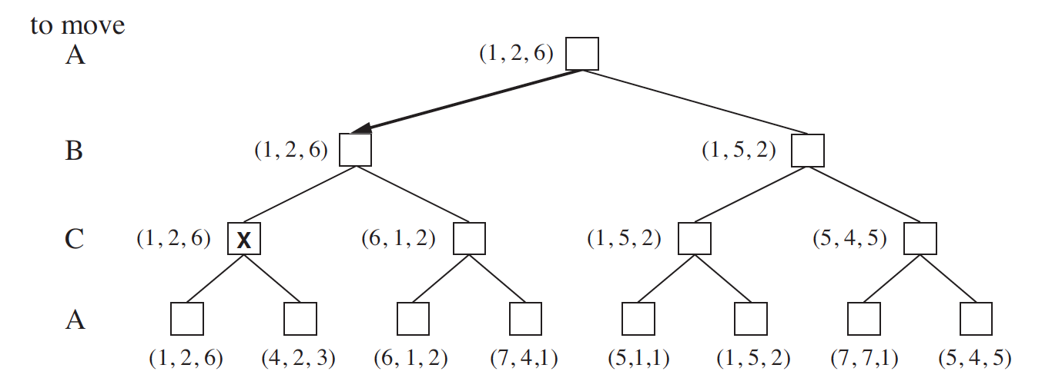
Multiplayer Games

Slide 41
Multiplayer Games
In Real Games, however
Multiplayer games involve alliances, whether formal or informal
Alliances are made and broken as the game proceeds
Are alliances a natural consequence of optimal strategies for each player in a multiplayer game?
Yes, if A and B are in weak positions and C is in strong position, A and B can form an alliance to attack C rather than each other

Slide 42
Thank You!
In our next session:
Alpha-Beta Pruning

